Slide 1



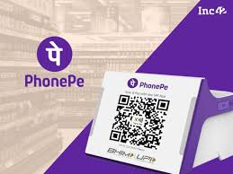

PHONEPE TRANSACTION INSIGHTS & RECOMMENDATIONS
Based on Data from Pulse GitHub Repository
Presented by: Bommidi Akash

Slide 2



Problem Statement
Gaining a comprehensive understanding of transaction dynamics, user engagement, and insurance data on PhonePe is paramount for enhancing service delivery, refining product offerings, and effectively targeting diverse user segments.
Project Focus
Analyzing and visualizing aggregated transaction values across payment categories, mapping total values at granular state and district levels, and identifying top-performing states, districts, and pincodes for strategic decisions.

Slide 3
Database Tables Overview
Aggregated tables: Summarized data (state, year, quarter) for overall trends.
map tables: Geographical data (districts) with user/transaction metrics.
top tables: Data for the highest-ranking entities (districts, pincodes).
:
Key Features Utilized
Geographical Identifiers: state, district, name/pincode for granular analysis.
Temporal Identifiers: year, quarter for time-series analysis.
Monetary Values: amount, total_insurance for financial volume assessment.
Counts/Volumes: count, registeredUsers, appOpens for user adoption and activity.
Categorical/Behavioral: transaction_type, brand for user preferences and ecosystem influence.
:

Slide 4
Business Use Cases & Strategic Implications
Customer Segmentation: Develop tailored marketing strategies and personalized services based on spending habits.
Fraud Detection: Analyze transaction patterns and anomalies to enhance platform security.
Geographical Insights: Inform targeted marketing campaigns and regional expansion based on payment trends at the state and district levels.
Payment Performance: Evaluate categories to guide strategic investments and optimize infrastructure.
User Engagement: Monitor activity metrics to enhance retention and satisfaction.
Product Development: Leverage data-driven insights for new features and enhancements.
Insurance Insights: Identify trends in policy adoption and improve offerings within the insurance vertical.
Marketing Optimization: Refine campaigns based on user behavior and regional performance for maximum ROI.
Trend Analysis: Examine trends to anticipate demand, forecast market shifts, and prepare for seasonal changes.
Competitive Benchmarking: Compare performance metrics to identify strengths and opportunities.

Slide 5

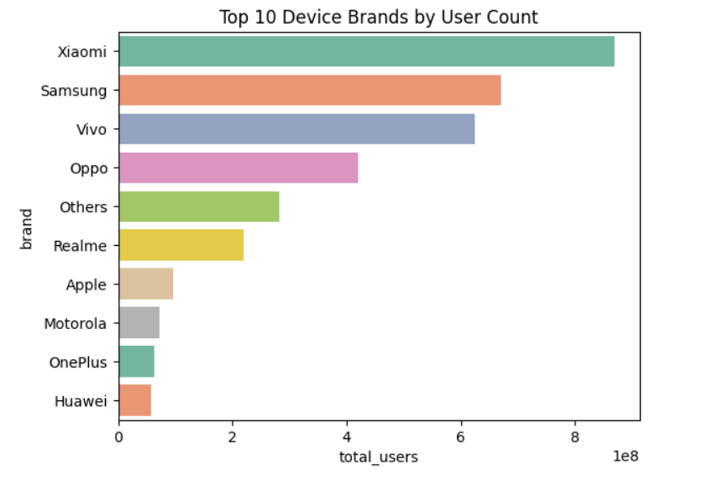
Key Finding 1: Smartphone Market Dominance
Implication
Finding: PhonePe's user base is significantly influenced by major smartphone brands. The analysis shows a strong correlation between the presence of leading smartphone brands (e.g., Xiaomi, Samsung, Vivo) and PhonePe's user distribution.
The choice of smartphone directly impacts the potential reach and user experience for PhonePe.
Recommendation
Collaborate closely with leading smartphone manufacturers (e.g., Xiaomi, Samsung, Vivo) to ensure deep integration and optimization of the PhonePe app.
Focus on delivering a seamless and superior experience for users on these dominant device ecosystems, as they represent the majority of the user base.

Slide 6
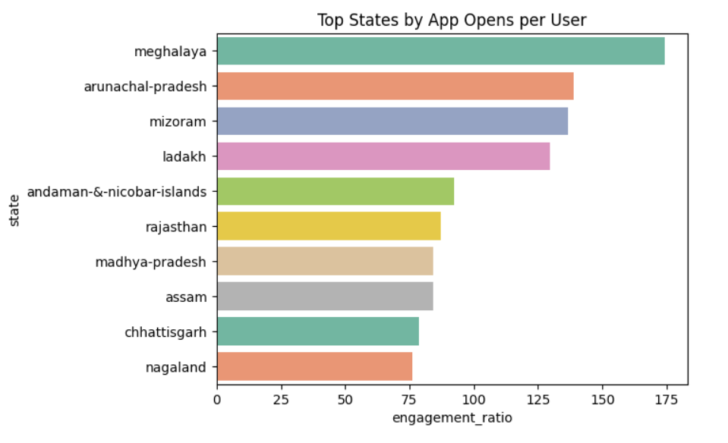
Key Finding 2: High Engagement in Key States
Implication
Finding: States like Meghalaya and Ladakh exhibit remarkably high app opens per user, indicating strong user engagement and platform stickiness in these regions.
Understanding the drivers of this high engagement can inform strategies for other states.
Recommendation
Conduct in-depth analysis to identify the specific factors contributing to high engagement ratios in Meghalaya and Ladakh (e.g., localized features, marketing campaigns, demographic fit).
Adapt and implement these successful strategies through targeted campaigns and personalized features to boost app opens per user in larger states that currently show lower per-user engagement.

Slide 7
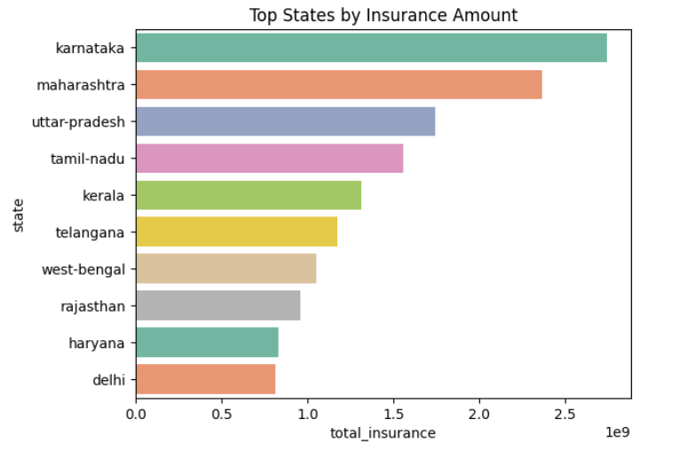
Key Finding 3: Strategic Insurance Expansion
Implication
Finding: The insurance segment on PhonePe is experiencing strong growth, presenting a significant opportunity for expansion and increased market share.
Capitalizing on this growth requires a focused approach to both high-volume and high-penetration regions.
Recommendation
Focus marketing and partnership efforts on high-volume states (e.g., Karnataka, Maharashtra) to maximize insurance transaction growth.
Simultaneously explore models to replicate the high insurance penetration seen in states like Kerala and Lakshadweep, aiming to increase insurance's share of total transactions in other regions.

Slide 8
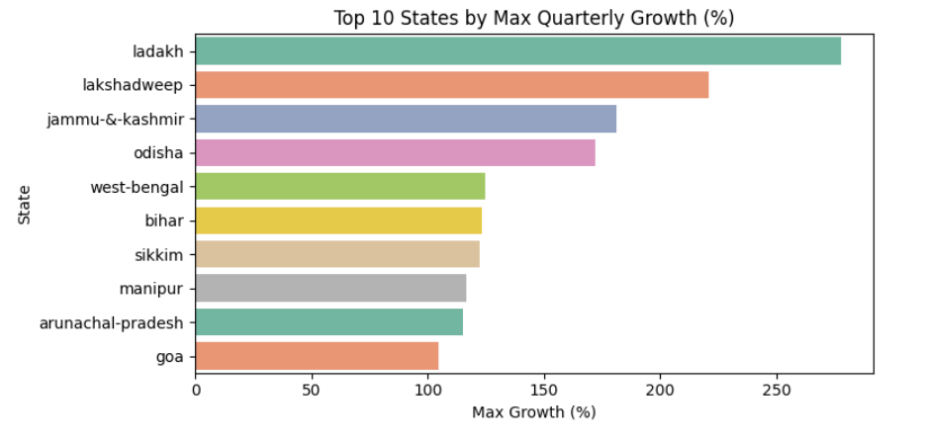
Key Finding 4: Invest in High-Growth Regions
Implication
Finding: Emerging high-growth states such as Ladakh, Lakshadweep, and Jammu & Kashmir, despite potentially smaller current transaction volumes, offer significant future potential for user acquisition and transaction growth.
Early investment in these regions can yield substantial long-term returns.
Recommendation
Develop tailored market entry and scaling strategies specifically designed for these emerging high-growth regions.
Prioritize investment in these areas to capitalize on their significant future potential for user acquisition and transaction growth.

Slide 9
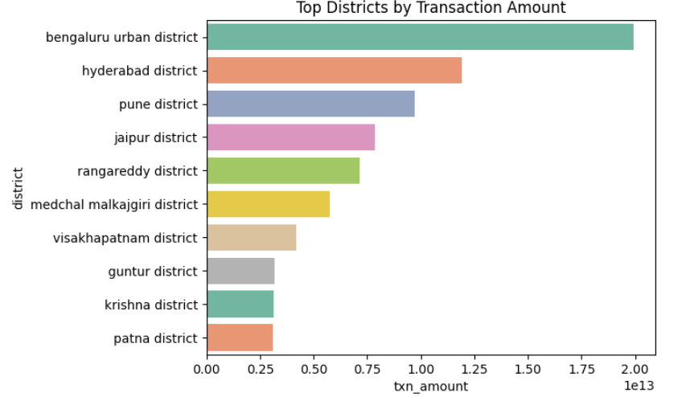
Key Finding 5: Granular Strategic Planning
Implication
Finding: The availability of district and pincode-level insights provides an unprecedented opportunity for hyper-local strategic planning.
This granular data allows for highly precise and efficient resource allocation.
Recommendation
Leverage district and pincode-level insights for hyper-local marketing campaigns, optimized sales force deployment, and specific product or service rollouts.
Ensure highly targeted and efficient resource allocation, maximizing impact and minimizing waste.

Slide 10

Conclusion: Key Recommendations
Collaborate with Smartphone Brands:
Strategic Insurance Expansion:
Drive Engagement in Key States:
Focus on high-volume states and replicate high-penetration models.
Optimize app for dominant device ecosystems.
Replicate success factors from high-engagement regions.
Invest in High-Growth Regions:
Granular Strategic Planning:
Develop tailored strategies for emerging markets.
Utilize district/pincode data for hyper-local initiatives.

Slide 11


Next Steps
Implement pilot programs in selected regions.
Develop detailed action plans for each recommendation.
Develop detailed action plans for each recommendation.
Develop detailed action plans for each recommendation.

Slide 12



THANK YOU!

